Slide 1
Title Slide
Title: Home Decor Store Subtitle: A Seamless Online Shopping Experience Tagline: "Transform Your Space with Style" Your Name/Team Name:

Slide 2
Project Objective
Create an online platform for users to explore and purchase home decor items (e.g., furniture, lighting, textiles).
Implement role-based access for users and admins to manage products, orders, and accounts.
Enable dynamic product filtering and a streamlined cart-to-checkout process.
Provide admins with tools to oversee inventory, orders, and user activity.

Slide 3
Technologies Used
Frontend: Responsive design with Bootstrap, JavaScript, CSS3
Backend: ASP.NET (C#), .NET Framework 4.8
Database: SQL Server (MDF file)
Tools: Visual Studio

Slide 4
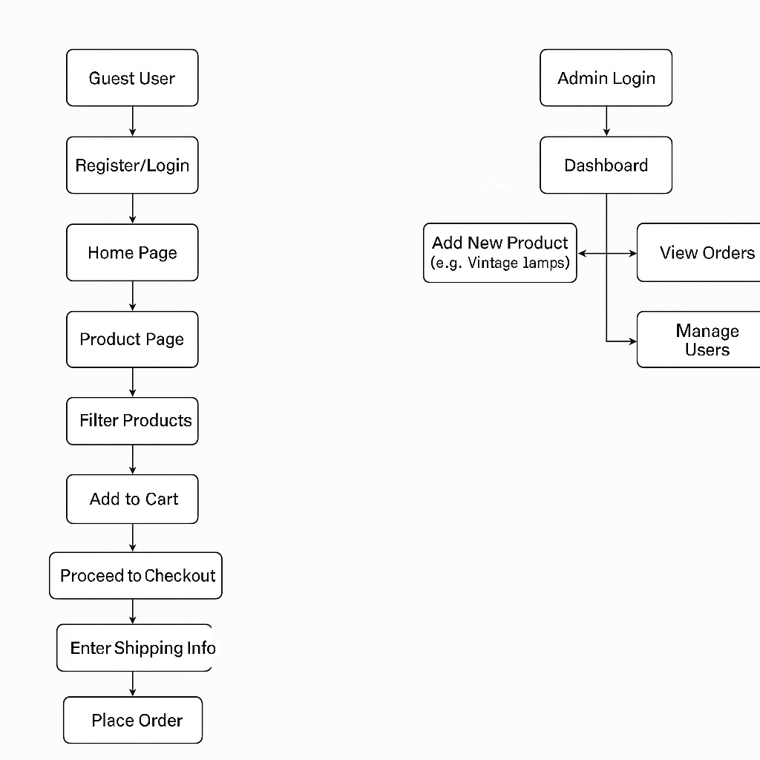
System Flow Diagram
User Flow:
Login/Register → Home Page → Browse Decor Collections → Filter by Category → Add to Cart → Checkout → Order Confirmation
Admin Flow:
Admin Login → Dashboard → Add/Edit Decor Items → Manage Orders → Update User Roles

Slide 5
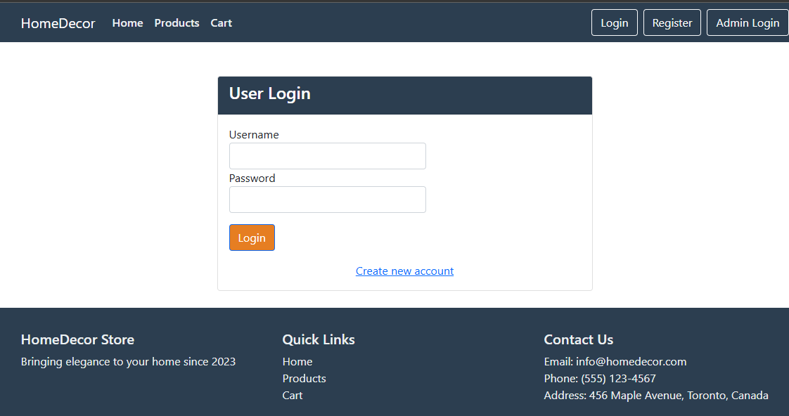
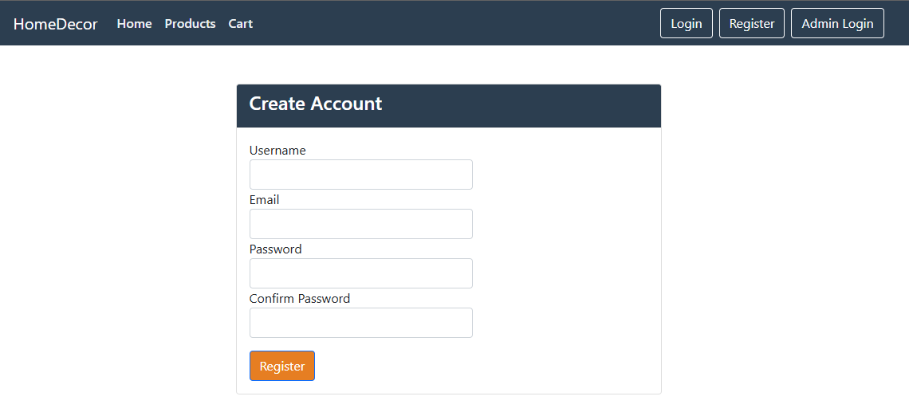
Login & Registration Page
Login Page:
Verifies user credentials against stored records.
Redirects successfully authenticated users to the home page.
Ensures secure login through password encryption.
Registration Page:
Gathers user information such as name, email, and address.
Validates that the email is unique to prevent duplicate registrations.

Slide 6
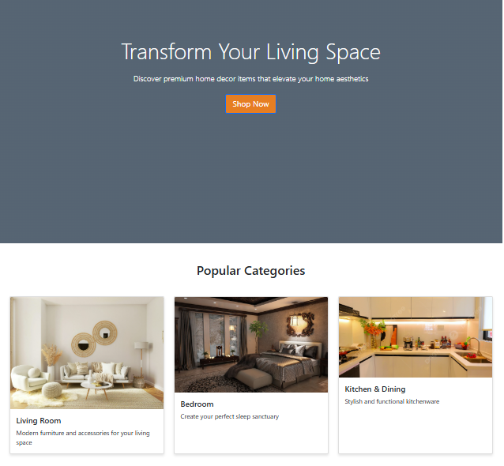
Home Page
The Home Page features a captivating tagline: "Transform Your Living Space — Discover premium home decor items that elevate your home aesthetics."
A prominent "Shop Now" button encourages user engagement and redirects visitors to the Product Page.
Below the banner, popular categories such as Bedroom, Living Room, and Kitchen are showcased to help users explore products effortlessly.

Slide 7
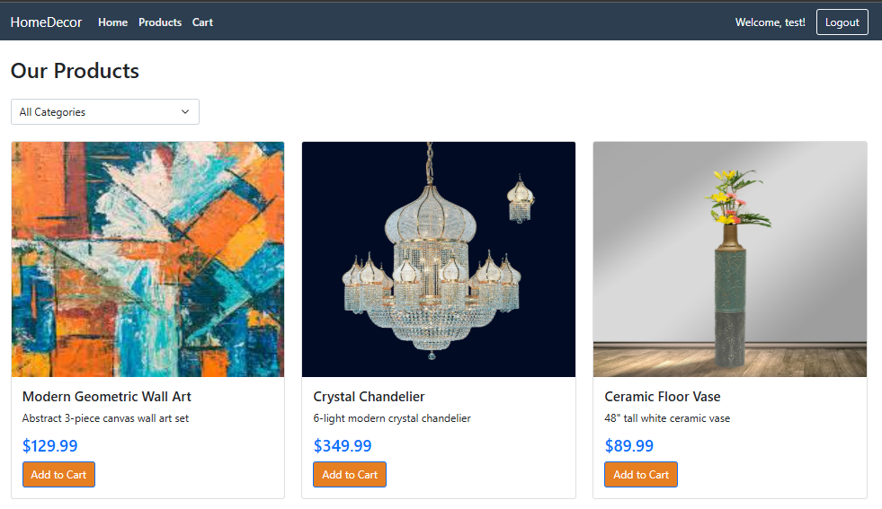
Product Page
The Product Page provides a dropdown menu that allows users to conveniently filter products by category, helping them quickly find items that match their interests or room type (e.g., Bedroom, Living Room, Kitchen).
All products are displayed in a clean and organized grid layout, showcasing high-quality images, product names, prices, and a clearly visible "Add to Cart" button for each item to streamline the shopping experience.

Slide 8
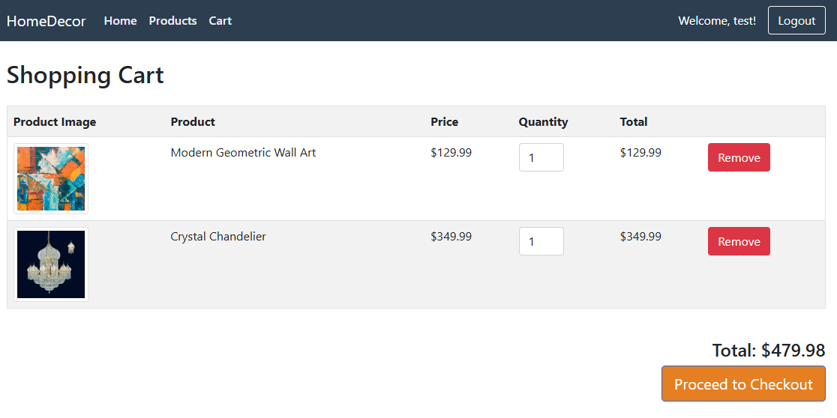
Cart Page
The Cart Page displays all the products added by the user, along with their selected quantities and the total calculated price.
Users can easily update their cart by removing individual items or directly proceed to the checkout process to finalize their purchase.

Slide 9
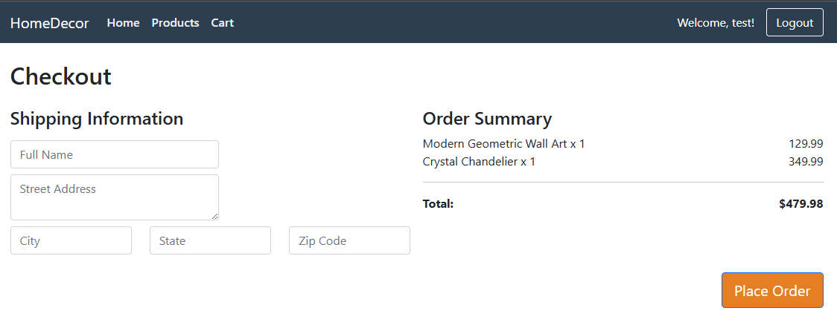
Checkout Page
Users are prompted to enter their shipping information, including address and contact number.
All input fields are validated for accuracy, such as ensuring the email format is correct and no required fields are left blank.
Once confirmed, the system records the order in the database and empties the user's cart to complete the purchase.

Slide 10
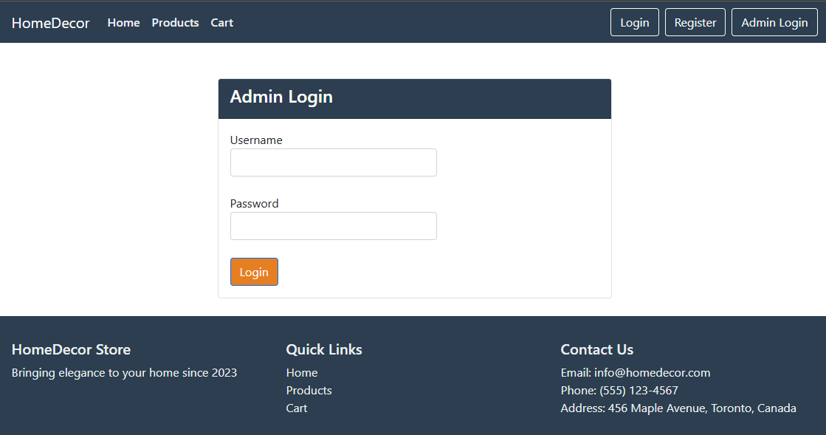
Admin Login
The system provides a dedicated login page exclusively for administrators to securely access backend functionalities.
Admins must enter valid credentials, which are authenticated against stored admin records.
Upon successful login, the admin is redirected to the Admin Dashboard, granting access to manage users, orders, and product listings.
This separation ensures secure access control and protects administrative features from unauthorized users.

Slide 11
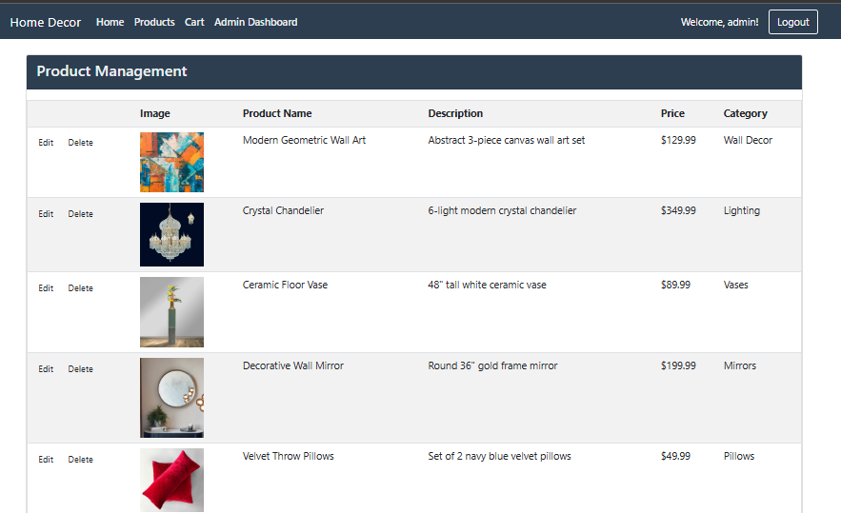
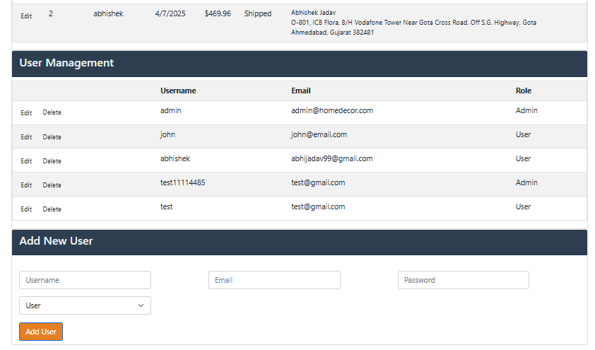
Admin Dashboard
Product Management:
Add new decor items (upload images, set prices).
Edit/remove outdated products.
Order Management:
View pending/completed orders.
Update delivery status (e.g., "Dispatched," "Delivered").
User Management:
Create new admin accounts.
Deactivate suspicious user profiles.

Slide 12
Conclusion
Successfully developed and deployed a fully functional online electronics showroom using ASP.NET WebForms and SQL Server, showcasing robust e-commerce capabilities. This project demonstrates practical expertise in full-stack web development, including frontend design, backend integration, and database management.
Implemented complete user and admin workflows, featuring functionalities like user authentication, product browsing, cart management, order placement, and a secure admin panel for product and user control. The platform not only enhances the online shopping experience but also provides a scalable solution for real-time order tracking and inventory updates.
This project reflects strong problem-solving abilities, attention to UI/UX, and a solid grasp of web application architecture – essential skills for modern web development.

